Slide 1
MAORAS ENTERPRISE SALES DASHBOARD
2014

Slide 2
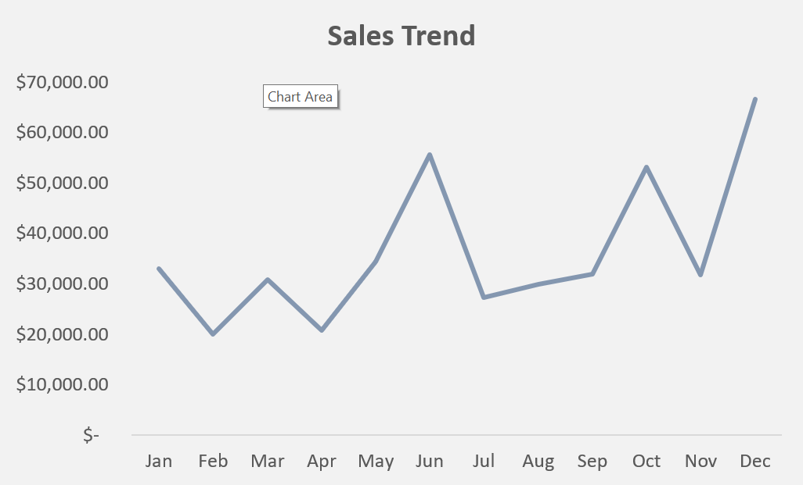
SALES TREND
INSIGHT
The business sees dips in sales during February, April, July, and November, likely due to seasonal factors.
RECOMMENDATION
The business should run targeted promotions during low-sales months, launch seasonal campaigns, increase resources during high-sales months, and engage customers with loyalty programs to boost overall revenue.

Slide 3
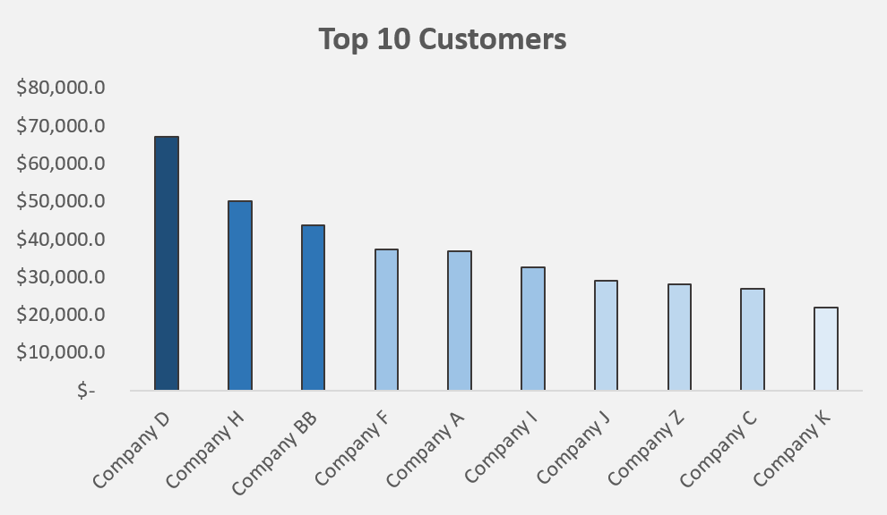
TOP 10 CUSTOMERS
INSIGHT
The company needs to focus on building strong relationships with top customers like Company D, also use a tiered strategy for different customer groups, explore growth opportunities with lower-tier customers, diversify the customer base to reduce risk.
REOMMENDATION
Build strong relationships with top customers, apply a tiered approach for managing different customer groups, seek growth opportunities with lower-tier customers, diversify the customer base, and tailor strategies based on customer segmentation.

Slide 4
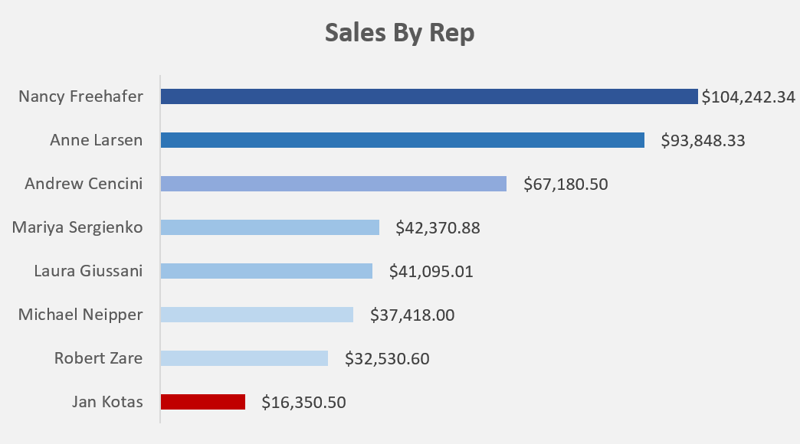
SALES BY REP
INSIGHT
Nancy Freehafer and Anne Larsen are the top performers, showing a significant revenue lead. There’s a performance gap between them and others.
RECOMMENDATION
Analyze and replicate the strategies of top performers, provide training and support to lower-revenue reps, share best practices across the team, set performance benchmarks, and regularly review and adjust strategies to improve overall sales performance.

Slide 5
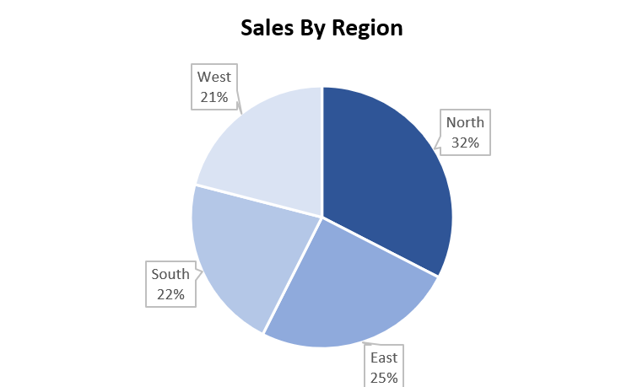
SALES BY REGION
INSIGHT
The Northern region leads in sales, while the Southern and Western regions lag behind.
RECOMMENDATION
The company needs to develop targeted strategies for the Southern and Western regions, analyze and address factors affecting their lower sales, allocate additional resources, use successful Northern region strategies as a model, and continuously monitor and adjust efforts to improve overall revenue.

Slide 6
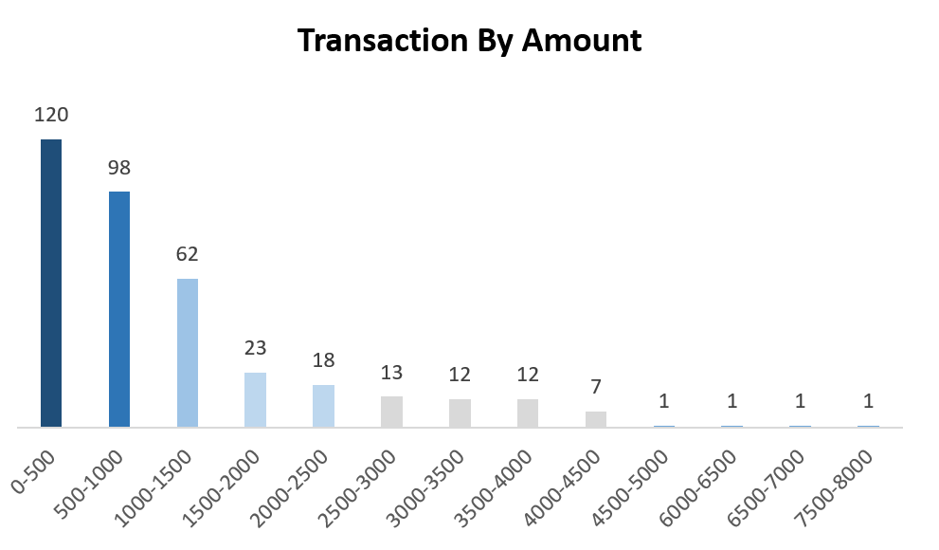
TRANSACTIONS BY AMOUNT
INSIGHT
Most transactions are in the lower price ranges, with a sharp decline in frequency as prices increase. This indicates price sensitivity among customers
RECOMMENDATION
Boost higher-priced sales through upselling, targeted marketing, and evaluating pricing strategies to attract more transactions in higher price ranges.

Slide 7
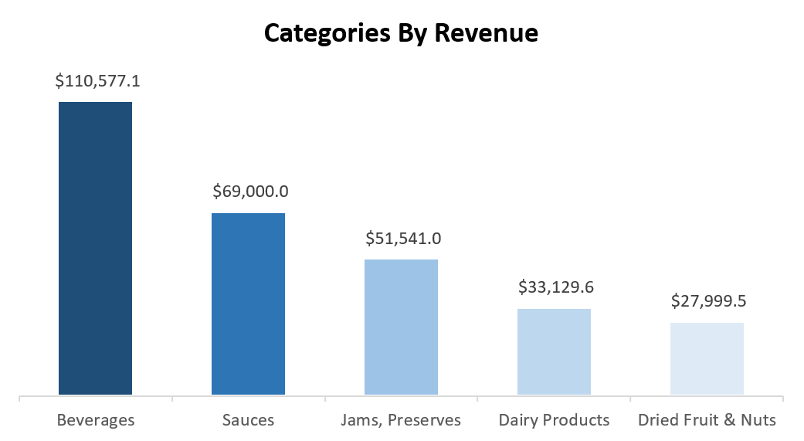
CATEGORIES BY REVENUE
INSIGHT
Beverages generate the highest revenue, followed by sauces and jams preserves. Dairy products and dried fruit & nuts have lower revenue.
RECOMMENDATION
The company should leverage the success of the beverages category and explore strategies to boost revenue in lower-performing categories like dairy products and dried fruit & nuts

Slide 8
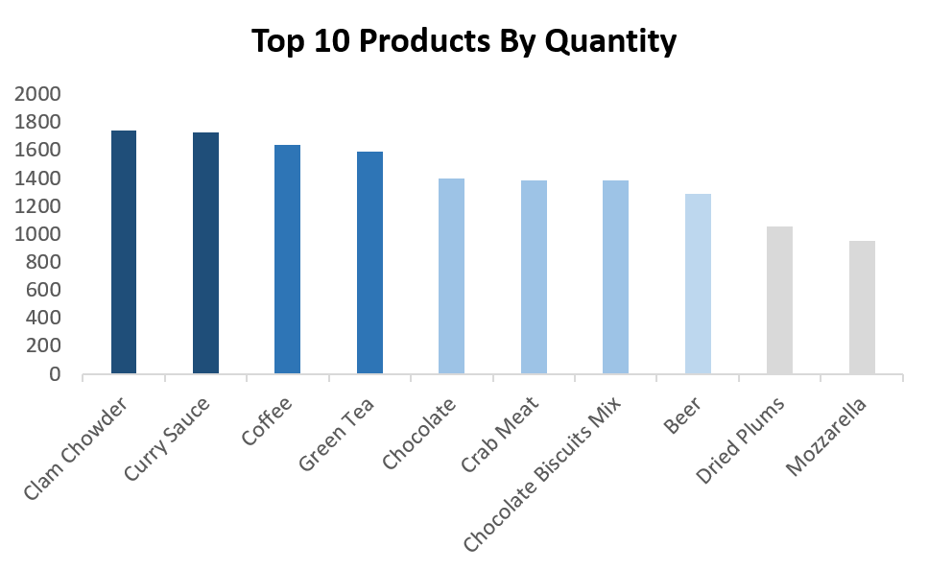
TOP 10 PRODUCTS BY QUANTITY
INSIGHT
Clam Chowder, Curry Sauce, Coffee, and Green Tea are the top-selling products by quantity, with strong performance
RECOMMENDATION
Promote and ensure adequate stock levels for top-selling products like Clam Chowder, Curry Sauce, Coffee, and Green Tea. Consider expanding offerings in high-demand categories.

Slide 9
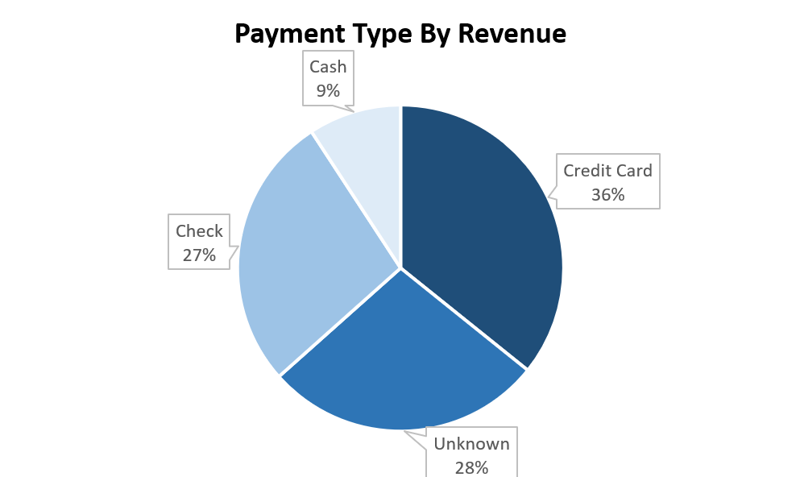
PAYMENT TYPE BY REVENUE
INSIGHT
Credit cards and checks are the most commonly used payment methods, while the unknown payment method accounts for a significant portion of transactions. Cash is the least used payment method at 9%, indicating less preference or availability for cash transactions.
RECOMMENDATION
Investigate and clarify the unknown payment method category to improve data accuracy and better understand customer payment preferences.

Slide 10
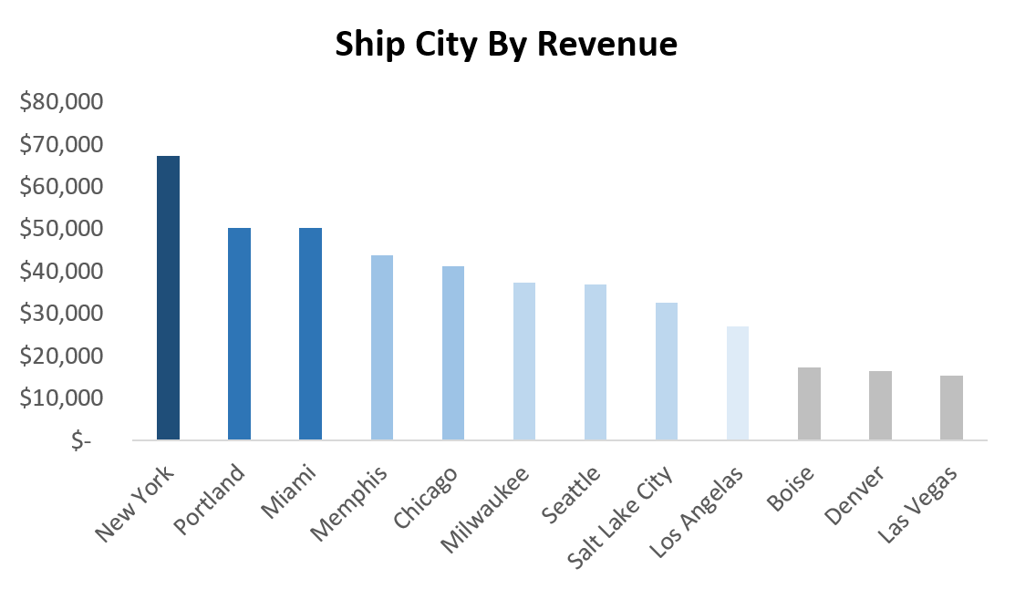
SHIP CITY BY REVENUE
INSIGHT
New York, Portland, and Miami generate the highest revenue, indicating strong markets. Moderate revenue is seen in cities like Memphis and Chicago, while Boise, Denver, and Las Vegas have lower revenue.
RECOMMENDATION
The company should enhance sales strategies in high-revenue cities like New York, Portland, and Miami, and explore opportunities to boost revenue in lower-performing cities such as Boise, Denver, and Las Vegas.

Slide 11
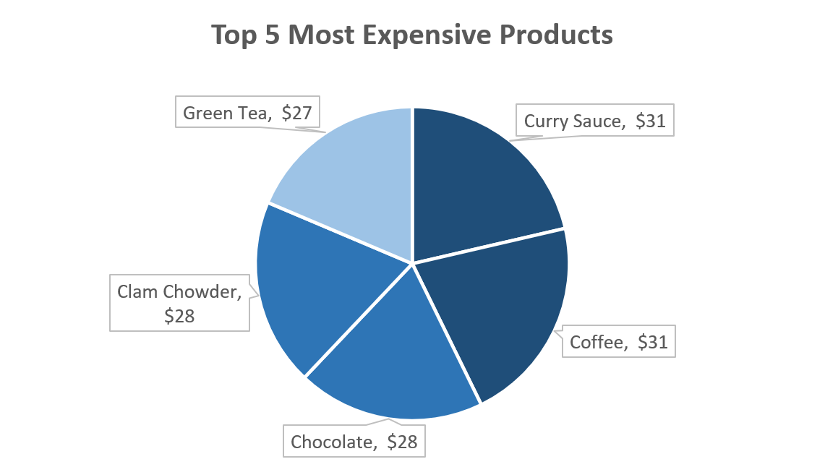
TOP 5 MOST EXPENSIVE PRODUCTS
INSIGHT
The top 5 most expensive products include Curry Sauce and Coffee being the highest priced at $31 each. These products offer higher margins but may have lower sales volumes.
RECOMMENDATION
Position the top 5 most expensive products as premium items and use bundling or promotional strategies to increase their sales

Slide 12
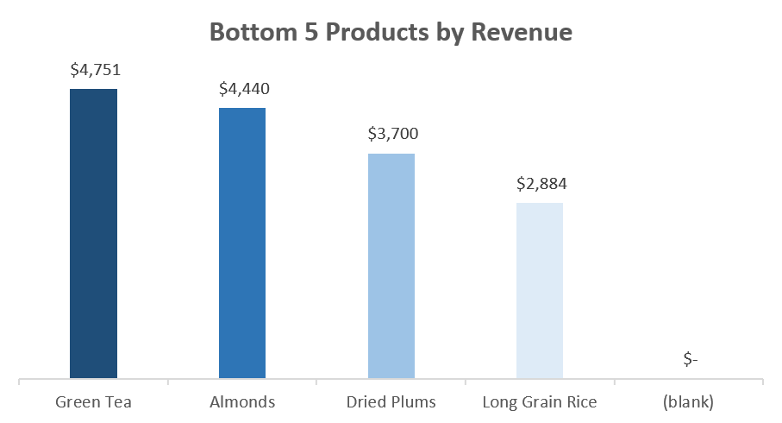
BOTTOM 5 PRODUCTS BY REVENUE
INSIGHT
Long Grain Rice, Dried Plums, Almonds, and Green Tea are among the lowest-revenue products
RECOMMENDATION
Enhance sales for low-revenue products by implementing targeted marketing, adjusting pricing, or improving product positioning to increase their market performance.

